Slide 1
A 2000
DAY JOURNEY
STRATEGIC PLAN | 2019-2023
Notes:
Welcome to the Success By 6 Coalition. We are so happy to have you here! There is a lot going on in our community, so let’s get you up to speed.

Slide 2
Early Childhood Stakeholder Meeting
July 23, 2020
A 2000
DAY JOURNEY
Our purpose:
Provide a learning community for early childhood stakeholders to share and discuss latest early childhood research
Provide an opportunity for stakeholders to learn about, share and discuss community conditions
Enable stakeholders to learn about progresses and challenges of coalition efforts and to provide feedback to in order to move the collective agenda forward
Facilitate networking with fellow stakeholders
Create a space for stakeholders to generate opportunities for action

Slide 3
AGENDA
3:00 Welcome
3:10 Strategic Plan Year 1 Update
3:25 Strategic Plan, Coalition and COVID-19 Response - Workgroup Updates
4:00 Break Out Groups (Choose one)
Coalition 101
Equity & Community Voice
Messaging and Communications for families
State policy & advocacy opportunities
4:30 Share out and SX6 Coalition Organizational News & Announcements
4:45 Adjourn
A 2000
DAY JOURNEY
Notes:
Norms: mute, use reactions, ask questions in chat box

Slide 4
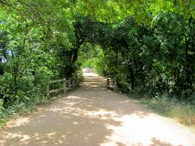
ICE BREAKER
A 2000
DAY JOURNEY
In the chat box, please type
Your name,
Organization you represent
a phrase to share your favorite COVID-19 Summertime Activity.

Slide 5
BREAKOUT GROUP POLL
Break Out Groups
Coalition 101
Equity & Community Voice
Messaging and Communications for families
State policy & advocacy opportunities
A 2000
DAY JOURNEY
Notes:
Longer group where we will focus on actionable ways that individuals can engage more personally.
State policy & advocacy opportunities: Writing your elected officials, testifying, PN-3 agenda at legislature, How can/should we engage volunteers? – email templates, (Brooke, Mary take notes)
Equity & Community Voice - How can we shape our stakeholder meetings and other communications/processes to better leverage the community, how can we advance equity? (Anna Lisa lead, Cathy take notes)
Coalition 101 - new to the Coalition? What questions do you have? What’s the difference between the LT and workgroups, can I get on a workgroup? (Alison, ? take notes)
Messaging and Communications for families – We have 5 points to promote, how can we better engage & communicate throughout the community (Ben, Shalyn, Martina?)

Slide 6
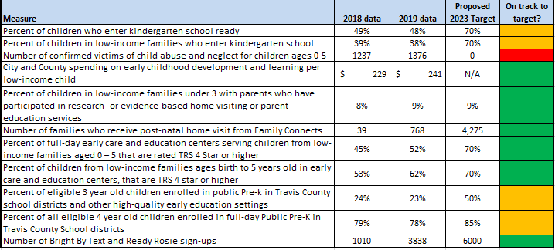
STRATEGIC PLAN YEAR 1 UPDATE
Dr. Alison Bentley
A 2000
DAY JOURNEY

Slide 7
STRATEGIC PLAN, COALITION, & COVID-19 RESPONSE
WORKGROUP UPDATES
A 2000
DAY JOURNEY

Slide 8
HEALTHY BEGINNINGS
Shalyn Bravens
A 2000
DAY JOURNEY
Keeping our kids and families healthy at this time has been our #1 priority –
supporting child care centers,
Family Connects nurse home visits for newborns,
messages for caregivers about community safety guidelines and basic needs resources,
combatting structural racism, &
proactively planning to overcome any decreases in vaccination rates,
Health has been at the forefront of everyone’s minds. We can do more and we will continue to seek out partners to strengthen this pillar of work.

Slide 9
Supported Families
Shalyn Bravens
A 2000
DAY JOURNEY
Newly prioritized areas include:
Family have access to basic needs resources, lifting up home-grown solutions that are effective for local families, & supporting children and families that have experienced trauma.
All young children have 20 books in their homes – more important than ever to have these materials in homes where kids are 24/7 at the moment.
Agencies supporting families are healthy and thriving,
Launch of ConnectATX call line

Slide 10
QUALITY CARE & EDUCATION
ANNA LISA CONLIN/CATHY DOGGETT
A 2000
DAY JOURNEY
The Child Care Sector is vital to the COVID19 Response
51% of programs are open and many are serving children of essential workers
Programs have pivoted quickly and with little resources to meet new health & safety protocols to mitigate transmission
Unfortunately, an estimated 50% of programs won’t survive financially
We are proposing sustainability funding to preserve programs
QC3 continues to support quality initiatives:
Enrollment is up in Teacher and Director TRAC and participants find great value in connection
We continue to work towards goal of bringing more centers into quality
We are prioritizing the coordination of child care with school districts

Slide 11
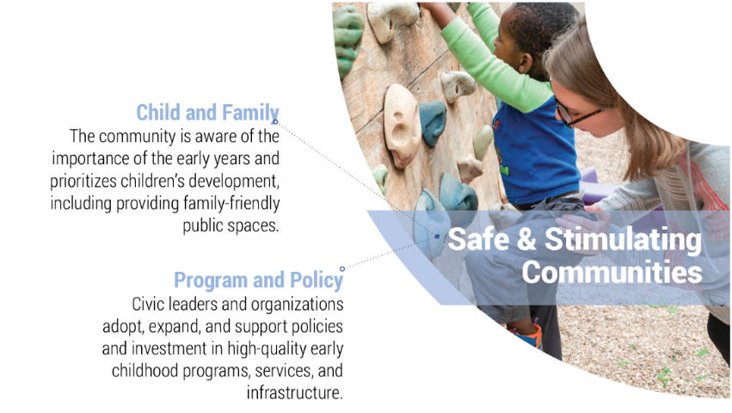
SAFE & STIMULATING COMMUNITIES
CATHY MCHORSE
A 2000
DAY JOURNEY
Emerging Priorities:
Coordination with City Departments to serve families with young children
Improved connection with Chamber of Commerce
Significant advocacy effort at City and State
ConnectATX COVID Resource Navigation
EMGA Family Friendly Initiative shifts to COVID response
Equity Assessment scheduled with COA Equity Office (August)
Assess Data Collection needs for COVID
Need: Digital Equity for families

Slide 12
A 2000
DAY JOURNEY
REFLECTIONS & QUESTIONS
Notes:
Offer brief opportunity to share in chat a reflection or question related to the updates.

Slide 13
BREAKOUT GROUPS
Break Out Groups
These will provide an opportunity for a deeper dive in a topic and opportunities for Stakeholders to learn more and take action at an individual level
Coalition 101 – Questions & Answers about the SX6 Coalition - Alison Bentley
Equity & Community Voice in our Coalition and Strategic Plan - Anna Lisa Conlin & Cathy McHorse
State policy & advocacy opportunities for Early Childhood: Brooke Freeland & Mary Jamsek
Messaging and Communications for Families – Ben Kramer & Martina Santesteban
A 2000
DAY JOURNEY
37%
Break Out Groups
Coalition 101
Equity & Community Voice Break Out Groups
Coalition 101
Break Out Groups
Coalition 101
Equity & Community Voice
Messaging and Communications for families
State policy & advocacy opportunities
Equity & Community Voice
Messaging and Communications for families
State policy & advocacy opportunities
Messaging and Communications for families
State policy & advocacy opportunities
93,000

Slide 14
COALITION 101
ALISON BENTLEY
A 2000
DAY JOURNEY
37%
SX6 Coalition Intro Video: https://youtu.be/G6MeVvoZykY
SX

Slide 15
EQUITY & COMMUNITY VOICE
ANNA LISA CONLIN/CATHY MCHORSE
A 2000
DAY JOURNEY
SX6’s equity journey:
Beyond Diversity & Undoing Racism
Work with COA equity office
Leadership Team - Scheduled Equity Assessment with COA Equity Office
Equity in COVID Child Care Task Force
Created Child Care Provider Task Force
How can SX6 further integrate equity approach and elevate community voice?
Who is doing this well in our community?
Who is doing this well in the EC sector?

Slide 16
5 KEY MESSAGES
BEN KRAMER/MARTINA SANTESTEBAN
A 2000
DAY JOURNEY
1. Wear a mask if you leave your home – every time. And if you must leave home, try to keep the numbers going with you to a minimum. These are the best ways to keep our community healthy. Remember, kids under the age of two should NOT wear masks because of the risk of suffocation.
2. Sign up for Bright By Text for timely resources, simple encouragements, and supports for caregivers: www.bit.ly/SMARTATX
3. For the well-being of young children, keep home routines going as much as you can, include daily talking, playing, reading, and singing.
4. Fill out the Census at www.MyCensus2020.gov to ensure our community has the resources and representation we need for the next 10 years.
5. Call 2-1-1 or visit www.ConnectATX.org to access information about basic needs, including food, childcare, mental health, physical safety, and more.
37%
93,000

Slide 17
POLICY & ADVOCACY OPPORTUNITIES
BROOKE FREELAND & MARY JAMSEK
A 2000
DAY JOURNEY
37%
3,000
See Separate Slide Deck from Break Out Session

Slide 18
FIVE KEY MESSAGES
A 2000
DAY JOURNEY
1. Wear a mask if you leave your home – every time. And if you must leave home, try to keep the numbers going with you to a minimum. These are the best ways to keep our community healthy. Remember, kids under the age of two should NOT wear masks because of the risk of suffocation.
2. Sign up for Bright By Text for timely resources, simple encouragements, and supports for caregivers: www.bit.ly/SMARTATX
3. For the well-being of young children, keep home routines going as much as you can, include daily talking, playing, reading, and singing.
4. Fill out the Census at www.MyCensus2020.gov to ensure our community has the resources and representation we need for the next 10 years.
5. Call 2-1-1 or visit www.ConnectATX.org to access information about basic needs, including food, childcare, mental health, physical safety, and more.
93,000

Slide 19
BRIEF SHARE OUT FROM BREAKOUTS
A 2000
DAY JOURNEY
ORGANIZATION NEWS & ANNOUNCEMENTS

Slide 20
WELCOME!
SUCCESS BY 6
www.SuccessBy6ATX.org
SuccessBy6@uwatx.org
Notes:
Welcome to the Coalition

